Slide 1
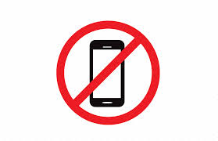
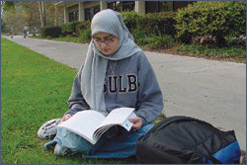
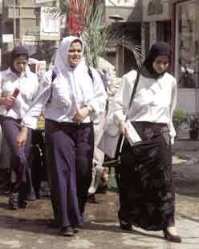
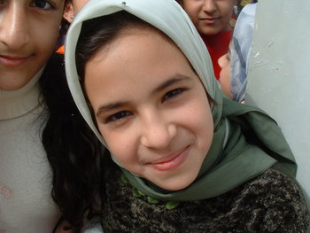
The Hijab and Islam

Slide 2
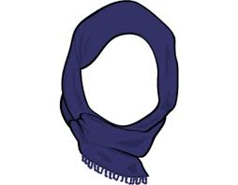
What is a hijab?
A hijab is a headscarf.
The word hijab comes from an Arabic word that means “to hide from view.”
Today, hijab refers to the modest covering of a Muslim woman.

Slide 3
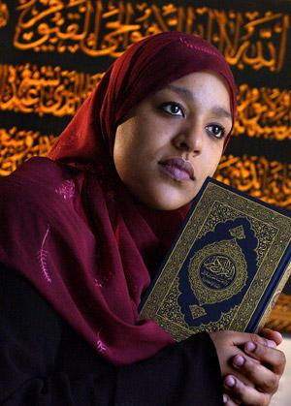
Why do Muslim women wear the hijab?

Slide 4
1. Allah Commands Muslims to be Modest
In the Qur’an, Allah commands women and men to be modest in all aspects of their life.
Women are called to not make their outward appearance the thing that defines them in society.
Women are called to avoid wearing revealing clothing so that they may be respected for who they are on the inside and not mistreated.
“O Prophet! Tell thy wives and daughters, and the believing women, that they should cast their outer garments over their persons (when abroad); that is most convenient, that they should be known (as such) and not molested. And Allah is Oft-Forgiving, Most Merciful.” (33:59)

Slide 5
2. The Hijab Liberates Women
We live in a society where the tendency is to judge people based on their outward appearance.
The less a woman wears, the more she is degraded and the more she is put in the line of fire of male criticism.
Through wearing the hijab, women must be judged based on what is inside of them.
Wearing the hijab helps women know who their true friends are.

Slide 6
The Hijab Liberates Women continued…
The University of California conducted a recent study and discovered that media photographs are more likely to emphasize the faces of men but the bodies of women.
In the average picture of a woman, less than half of the photo (45%) captured the woman’s face.
In the pictures of men, nearly two-thirds (65%) of the photograph focused on the man’s face.
The hijab can help women maintain their dignity.

Slide 7
3.The Hijab Provides Muslim Woman with an Identity
Through wearing a hijab, Muslim women usually do not have to tell people that they are Muslims.
The hijab has become a visible symbol of the Islamic faith.

Slide 8
4. The Hijab can Foster Understanding
The hijab can help spark meaningful conversations.
Since it is a visible symbol of the Islamic faith, it might encourage non-Muslims to learn more about Islam.

Slide 9
Women Try Wearing the Hijab for a Day
https://www.youtube.com/watch?v=i4jzlxlpJLM

Slide 10
Source:
Why do Muslim Women Wear the Hijab? Islam for Today. Retrieved from www.islamfortoday.com/hijabcanada4.htm

