Slide 1
The Sun Dance

Slide 2
What is the Sun Dance?
It is a ceremony that is generally held during the summer by peoples of the Prairies.
Participants will purify themselves to prepare for the dance (eg. sweat lodge ceremony).
During the dance, participants will dance.
It celebrates:
renewal
the spiritual rebirth of the participants and their families
regeneration of the living earth and all of its components

Slide 3
What is controversial about the Sun Dance?
During the final stage of the dance, participants will sometimes be attached to a pole by hooks in through their flesh.
Essentially, this action allows participants to offer the Spirit the only thing that is truly theirs - their own flesh.
Through offering their flesh, they participants hope to rouse the Spirit’s pity and help.

Slide 4
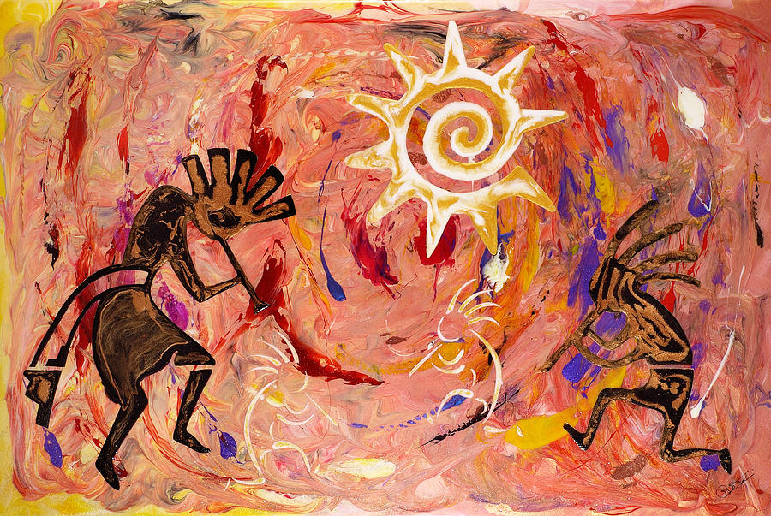
A Painting Depicting The Sun Dance

Slide 5
Sources:
Tokarski, P. (2010). Retrieved from: http://fineartamerica.com/featured/sun-dance-paul-tokarski.html
World Religions: A Canadian Catholic Perspective. Toronto: Novalis Publishing Inc., 2011.

