Slide 1
Types of Truth

Slide 2
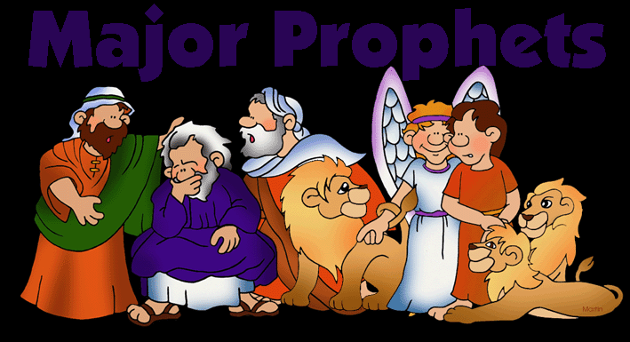
Religious Truth
“Truth based on faith”
Example: God tries to communicate with people through their lives

Slide 3
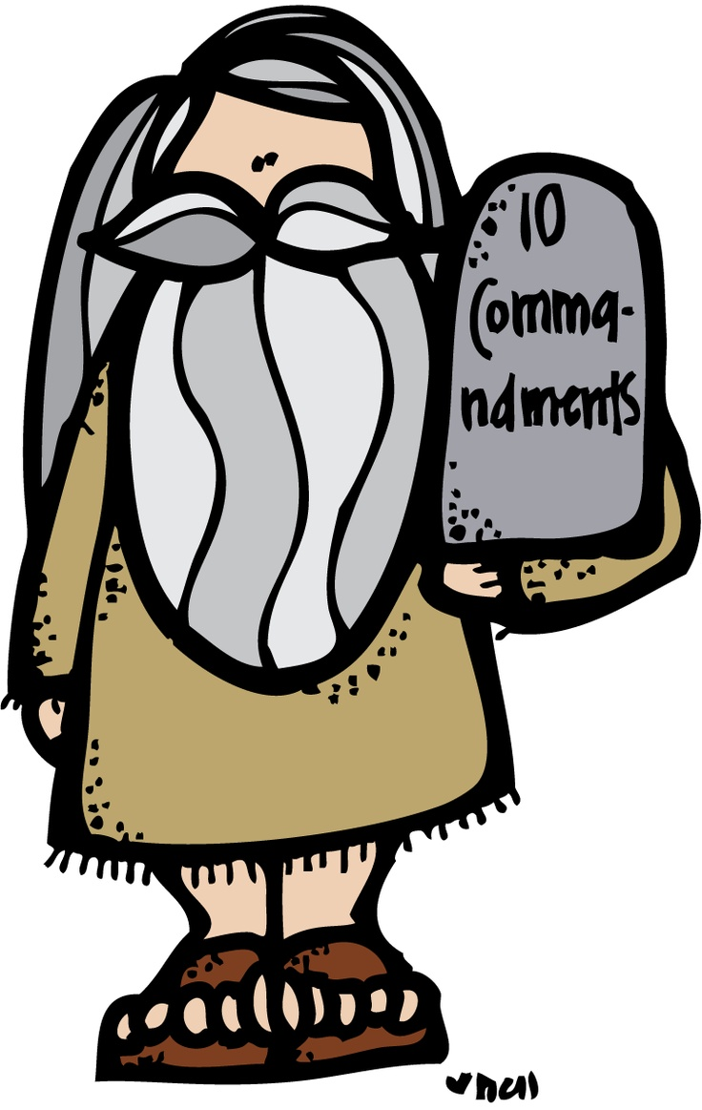
Moral Truth
“The distinction between wrong and right”
Example: “Thou shall not kill”

Slide 4
Symbolic Truth
“Something used for or regarded as representing something else”
Example: “If your eyes cause you to sin, pluck them out”

Slide 5
Proverbial Truth
“A short popular saying, usually of unknown and ancient origin that expresses effectively some commonplace truth or useful thought”
Example: “The early bird catches the worm”

Slide 6
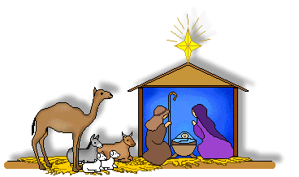
Historical Truth
“Knowledge that deals with past events”
Example: Jesus was born in Bethlehem and lived in Nazareth

Slide 7
Scientific Truth
“A branch of knowledge or study dealing with a body of facts or truths”
Example: 2 + 2 = 4

Slide 8
Source:
“HRE1O Truths and Terms of the Bible.” Retrieved from: https://docs.google.com/presentation/d/13bXGJEQ1L8zEqCwouatkcanRwIa-DhONPogF0UwQFNs/edit#slide=id.p22

