Slide 1
WW1 Weapons Report Card Comments

Slide 2
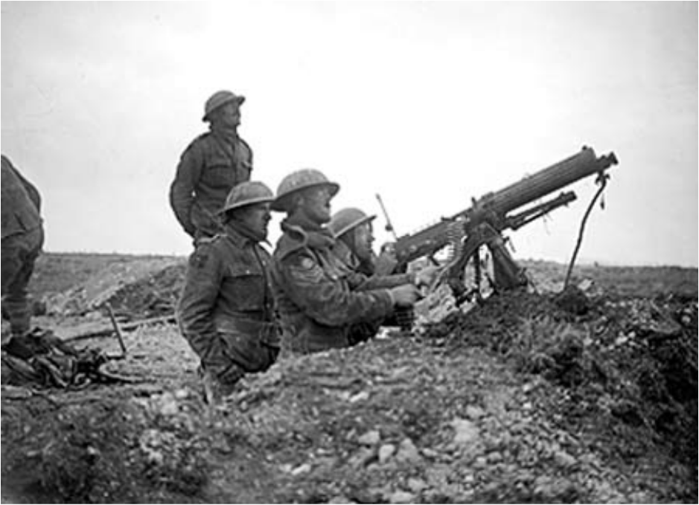
Machine Guns
An advantage: It could fire 400-600 rounds per min.
Not reliable: It fired bullets so fast that the gun could easily overheat. Water was not always available to cool off the gun.
Casualties: Many soldiers could be gunned down quickly.

Slide 3
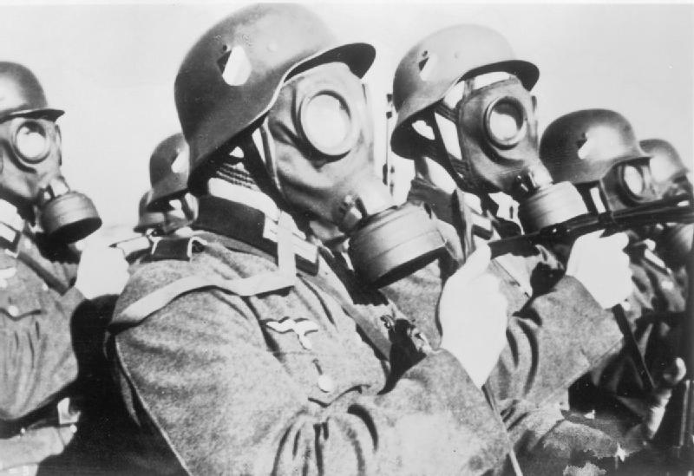
Chemical Weapons
Not an advantage: A wind going in the direction you wanted was needed to carry the gas toward the enemy.
Not reliable: If the wind changed, the attack could backfire.
Causalities: The gas usually disappeared quickly once released so it couldn’t cause that much damage. The soldiers using the gas to attack their enemy could be affected negatively by the gas (change in wind direction).

Slide 4
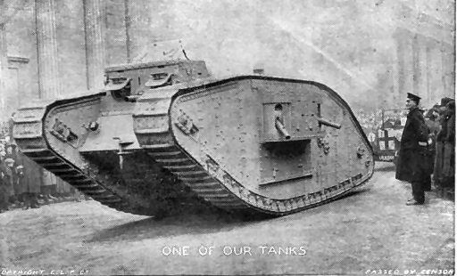
Tanks
Advantage: They could cross trenches and plow through barbed wire and other barriers. Their metal armour protected them from machine gun fire and shrapnel.
Reliable: The first tanks were slow and awkward. They often broke down or got stuck in the mud of no man’s land.
Casualties: The engine heat and fumes nearly choked the men inside. However, the men could be protected from gun fire and shrapnel.

Slide 5
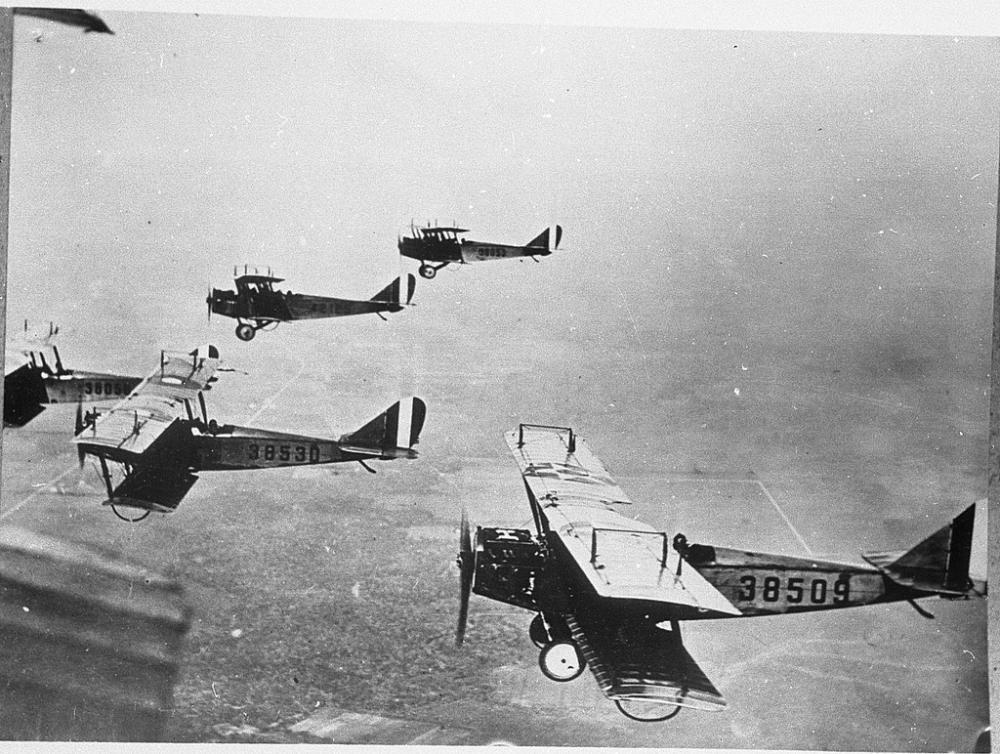
Airplanes
Advantage: Pilots could take pictures of the enemy. Later, they could shoot down enemy planes or drop bombs. The Germans were the first to fire bullets between the propeller blades from a machine gun.
Reliable: Initially they could not carry bombs or guns. However, that eventually changed and they could shoot and drop bombs.
Casualties: Equipping the planes with machine guns and bombs increased the number of casualties.

Slide 6
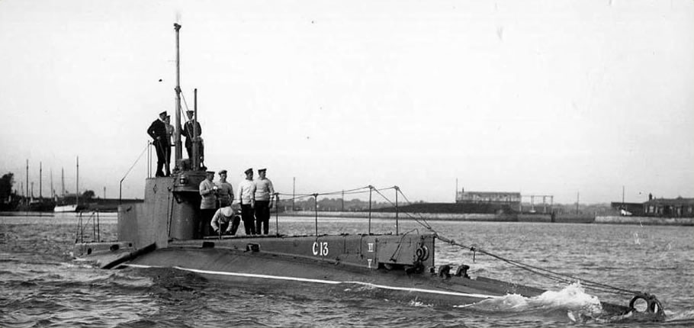
Submarines
Advantage: A submarine could be used for a surprise attack on enemy ships because they were not always noticeable.
Not reliable: Destroyers (speedy ships) could eventually find submarines and drop a depth charge (bomb) that exploded the submarines underwater.
Casualties: Many ships could be sunk through using undetected submarines.

Slide 7
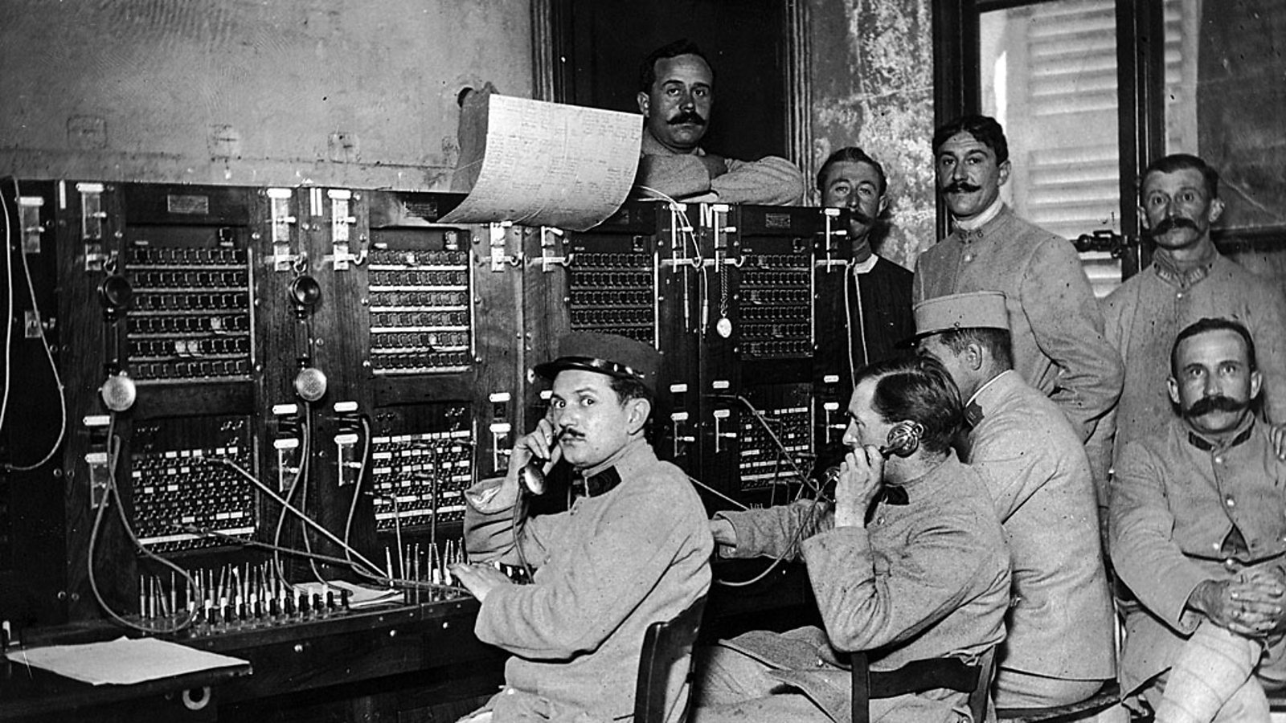
Telephones and Radios
Telephones gave an advantage: Commanders could talk directly to officers and give out orders immediately.
Telephones were not reliable: Field telephones required wires and these needed to be strung. The wires could easily be broken by enemy artillery.
Radios gave an advantage: No wires were needed. Ships could communicate with their home base and with other ships.
Radios were reliable: A distress signal or general message could be sent by radio from a long distance away.

Slide 8
Source
J. Penney.

